Slide 1
Plant Layout
Presentation by: Chetan Raikwar

Slide 2
What is facility layout ?
Layout provides some kind of product/service.
Client needs this kind of service.
‘GOODS’
SERVICE
Notes:
General office, information center

Slide 3
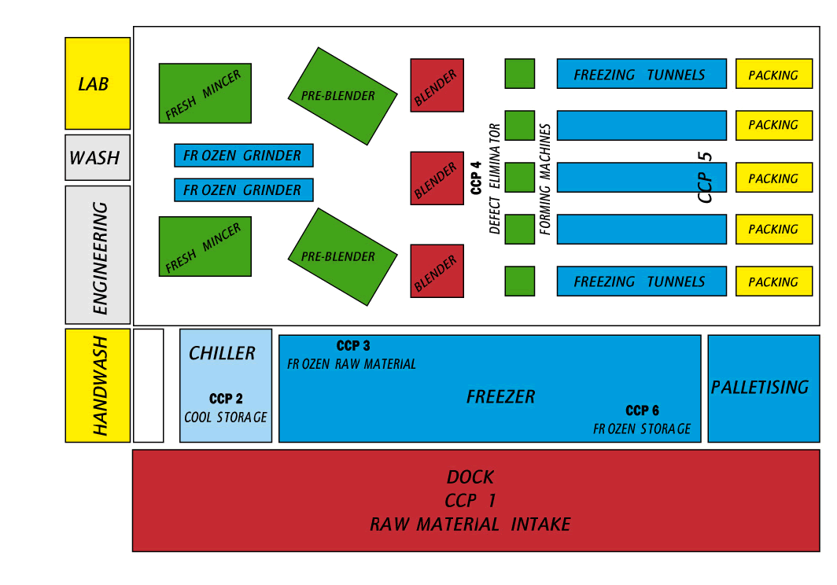
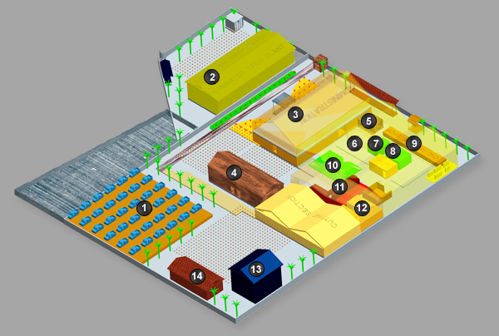
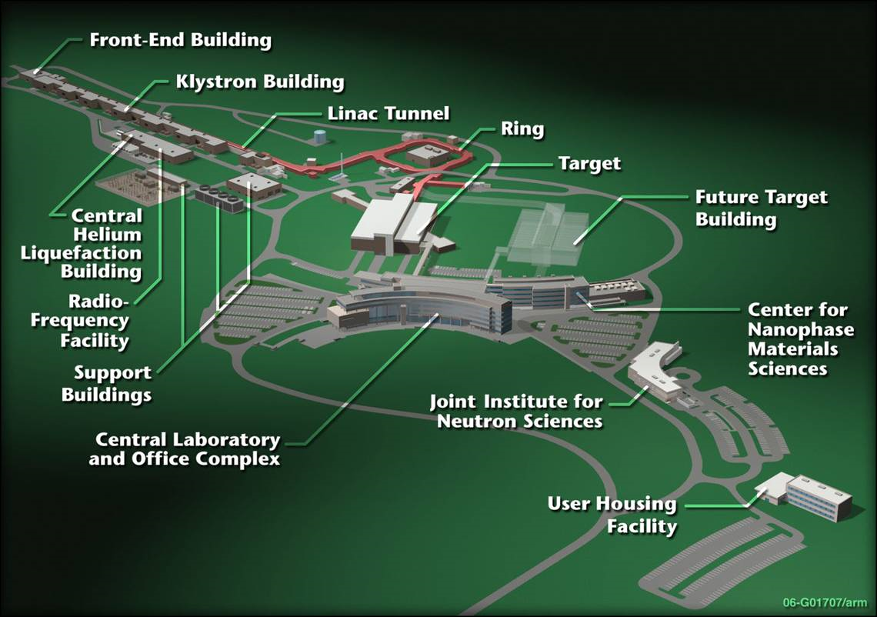

Slide 4
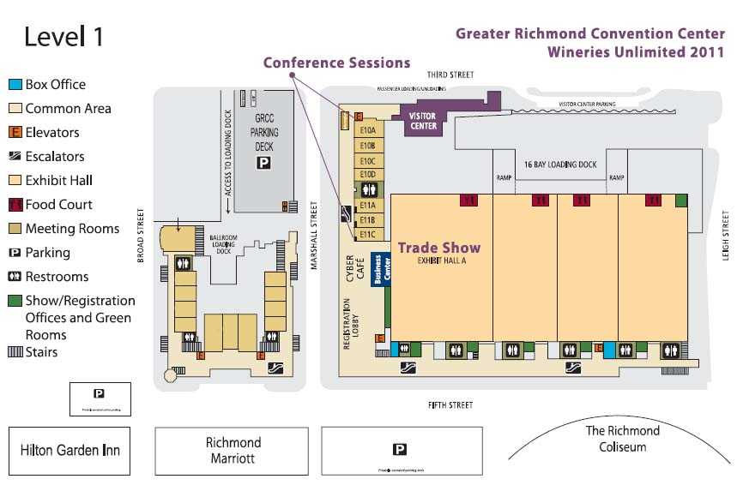

Slide 5

The Need for Layout Decisions
Inefficient operations
Changes in the design
of products or services
For Example:
High Cost
Bottlenecks
The introduction of
new products or services
Accidents
Safety hazards

Slide 6
The Need for Layout Design (Cont’d)
Changes in
environmental
or other legal
requirements
Changes in volume of
output or mix of
products
Morale problems
Changes in methods
and equipment

Slide 7
Introduction
Plant layout refers to the physical arrangement of production facilities.
Layout decisions entail determining the placement of departments, work groups within the departments, workstations, machines, and stock-holding points within a production facility.
The objective is to arrange these elements in a way that ensures a smooth work flow (in a factory) or a particular traffic pattern (in a service organization).

Slide 8
Layout: The configuration of departments, work centers, and equipment, with particular emphasis on movement of work (customers or materials) through the system.
Plant Layout: Plant layout refers to the arrangement of physical facilities such as machines, equipment, tools, furniture etc. in such a manner so as to have quickest flow of material at the lowest cost and with the least amount of handling in processing the product from the receipt of raw material to the delivery of the final product.

Slide 9
According to Moore “Plant layout is a plan of an optimum arrangement of facilities including personnel, operating equipment, storage space, material handling equipment and all other supporting services along with the design of best structure to contain all these facilities”.
Layout decisions are important for three basic reasons:
Require substantial investments of money and
effort.
It Involve long-term commitments, which makes
mistakes difficult to overcome.
Have a significant impact on the cost and efficiency
of operations.

Slide 10
Objectives of Plant layout

Slide 11
The primary goal of the plant layout is to maximize the profit by arrangement of all the plant facilities to the best advantage of total manufacturing of the product.
Effective utilization of men, equipment and space.
Streamline the flow of materials through the plant.
Minimize investment in equipment.
Minimize overall production time.
Maintain flexibility of arrangement and operation.
Minimize materials handling and cost.
Provide for employee convenience, safety and comfort.
Flexibility of manufacturing operations and arrangements.
Facilitate the organizational structure.
Facilitate the manufacturing process.

Slide 12
Principles of Plant Layout
Principle of integration
Principle of minimum handling
Principle of minimum distance
Principle of flow
Principle of maximum flexibility
Principle of safety, security and satisfaction
Principle of cubic space utilization

Slide 13
Types of Layout
1. Product Layout
A product layout (also called a flow-shop layout) is one in which equipment or work processes are arranged according to the progressive steps by which the product is made. The path for each part is, in effect, a straight line.

Slide 14
Production lines for shoes, chemical plants, and car washes are all product layouts.
In product layout, equipment or departments are dedicated to a particular product line, duplicate equipment is employed to avoid backtracking, and a straight-line flow of material movement is achievable.

Slide 15
In this type of layout, machines and auxiliary services are located according to the processing sequence of the product.
If the volume of production is large, the facilities can be arranged to achieve efficient flow of materials and lower cost per unit.

Slide 16
Special purpose machines are used which perform the required function quickly and reliably.
The material moves to another machine sequentially without any backtracking or deviation i.e the output of one machine becomes input of the next machine.
It requires a very little material handling.
It is used for mass production of standardized products. E.g. Sugar mill and paper mill.

Slide 17
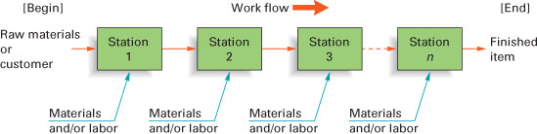

Product layouts are used to achieve a smooth and rapid flow of large volumes of goods or customers through a system.

Slide 18
Advantages of Product layout:
Low cost of material handling, due to straight and short route and absence of backtracking
Smooth and continuous operations
Continuous flow of work
Lesser inventory and work in progress
Optimum use of floor space
Simple and effective inspection of work and simplified production control
Lower manufacturing cost per unit
Throughput time is less.

Slide 19
Disadvantages of Product layout:
Higher initial capital investment in special purpose machine (SPM)
High overhead charges
Breakdown of one machine will disturb the production process.
Lesser flexibility of physical resources.
A change in product design may require major alterations in the layout.

Slide 20
2. Process layout
A process layout (also called a job-shop or functional layout) is a format in which similar equipment or functions are grouped together, such as all lathes in one area and all stamping machines in another.
A part being worked on then travels, according to the established sequence of operations, from area to area, where the proper machines are located for each operation.
This type of layout is typical of hospitals, for example, where areas are dedicated to particular types of medical care, such as maternity wards and intensive care units.

Slide 21
Process layout is recommended for batch production. All machines performing similar type of operations are grouped at one location in the process layout e.g., all lathes, milling machines, etc. are grouped in the shop will be clustered in like groups.
Similar equipments and operations are grouped together. For example, turning, milling, foundry, heat treatment. Items which require these operations are frequently moved in batches to the departments in a sequence dictated by technical considerations.

Slide 22
These layouts, also known as “Functional Layout’ is process focused systems and are used widely in manufacturing and service sectors.
The use of general purpose machines provides flexibility necessary to handle a wide range of processing requirements. Workers who operate the equipments are usually skilled or semi-skilled.
This type of layout is used for batch production. It is preferred when the product is not standardized and the quantity produced is very small.

Slide 23
Process layout is normally used when the production volume is not sufficient to justify a product layout. Typically, job shops employ process layouts due to the variety of products manufactured and their low production volumes.
The example of process layout includes hospitals, colleges and universities, banks, airlines and public libraries.

Slide 24
Process Layout
(functional)
Dept. A
Dept. C
Dept. E
Dept. B
Dept. D
Dept. F
Used for Intermittent processing
Job Shop or Batch

Slide 25
Advantages of Process layout:
Lower initial capital investment is required.
There is high degree of machine utilization, as a machine is not blocked for a single product
Breakdown of one machine does not disturb the production process.
Supervision can be more effective and specialized.
It has greater flexibility and utilization of resources.
The overhead costs are relatively low

Slide 26
Disadvantages of Process layout:
Material handling costs are high due to backtracking
More skilled labour is required resulting in higher cost.
Work in progress inventory is high needing greater storage space
More frequent inspection is needed which results in costly supervision
Throughput (time gap between in and out in the process) time is longer.

Slide 27
3. FIXED POSITION OR LOCATION LAYOUT
This is also called the project type of layout. In this type of layout, the material, or major components remain in a fixed location and tools, machinery, men and other materials are brought to this location.
In a fixed-position layout, the product (by virtue of its bulk or weight) remains at one location.
Fixed position layout involves the movement of manpower and machines to the product which remains stationary. The movement of men and machines is advisable as the cost of moving them would be lesser. This type of layout is preferred where the size of the job is bulky and heavy. Example of such type of layout is locomotives, ships, boilers, generators, wagon building, aircraft manufacturing, etc.

Slide 29
Advantages of Fixed position layout:
The investment on layout is very small.
The layout is flexible as change in job design and operation sequence can be easily incorporated.
Adjustments can be made to meet shortage of materials or absence of workers by changing the sequence of operations.
Disadvantages of Fixed position layout:
As the production period being very long so the capital investment is very high.
Very large space is required for storage of material and equipment near the product.
As several operations are often carried out simultaneously so there is possibility of confusion and conflicts among different workgroups.

Slide 30
4. Group Layout or Cellular Layout:-
Group Technology (GT) is the analysis and comparisons of items to group them into families with similar characteristics. GT can be used to develop a hybrid between pure process layout and pure flow line (product) layout. This technique is very useful for companies that produce variety of parts in small batches to enable them to take advantage and economics of flow line layout.
Thus group layout is a combination of the product layout and process layout. It combines the advantages of both layout systems. If there are m-machines and n-components, in a group layout (Group-Technology Layout), the m-machines and n-components will be divided into distinct number of machine-component cells (group) such that all the components assigned to a cell are almost processed within that cell itself.
Group technology (or cellular) layout allocates dissimilar machines into cells to work on products that have similar shapes and processing requirements.

Slide 31
Group technology (GT) layouts are now widely used in metal fabricating, computer chip manufacture, and assembly work.
The overall objective is to gain the benefits of product layout in jobshop kinds of production. These benefits include
Better human relation: Cells consist of a few workers who form a small work team; a team turns out complete units of work.
Improved operator’s expertise. Workers see only a limited number of different parts in a finite production cycle, so repetition means quick learning.
Less in-process inventory and material handling. A cell combines several production stages, so fewer parts travel through the shop.
Faster production setup: Fewer jobs mean reduced tooling and hence faster tooling changes.

Slide 32
Advantages of Group Technology Layout
Group Technology layout can increase
Component standardization and rationalization.
Reliability of estimates.
Effective machine operation and productivity.
Customer service.
It can decrease the—
Paper work and overall production time.
Work-in-progress and work movement.
Overall cost.
Limitations of Group Technology Layout: This type of layout may not be feasible for all situations. If the product mix is completely dissimilar, then we may not have meaningful cell formation.

Slide 33
Example of order processing in cellular layout:
A. The same example of an ordered processed in a cellular layout

Slide 34
Functional vs. Cellular Layouts
Dimension | Functional | Cellular
Number of moves between departments | Many | Few
Travel distances | Longer | Shorter
Travel paths | Variable | Fixed
Job waiting times | Greater | Shorter
Throughput time | Higher | Lower
Amount of work in process | Higher | Lower
Supervision difficulty | Higher | Lower
Scheduling complexity | Higher | Lower
Equipment utilization | Lower | Higher

